Slide 1
Introduction to Operating Systems

Slide 2
What is The Matrix? (also known as OS among students)
Unfortunately no one can be told what the matrix is.
You have to see it yourself!

Slide 3

Are you ready?

Slide 4
Let’s get started!
https://www.youtube.com/watch?v=vKQi3bBA1y8

Slide 5

Welcome to CENG334!
What is this course about?
Operating Systems drive the inner workings of virtually every computer in the world today
PCs, servers, iPods, cell phones, missile guidance systems, etc. all have an OS that dictate how they operate.
The OS manages many aspects of how programs run, and how they interact with hardware and the outside world.
Understanding the OS is essential for understanding:
System performance and reliability
Resource management
Virtualization and abstraction
Concurrency and parallelism
Hardware interfaces and I/O
This course is about more than just “kernel internals”
It is really about learning complex systems design.

Slide 6

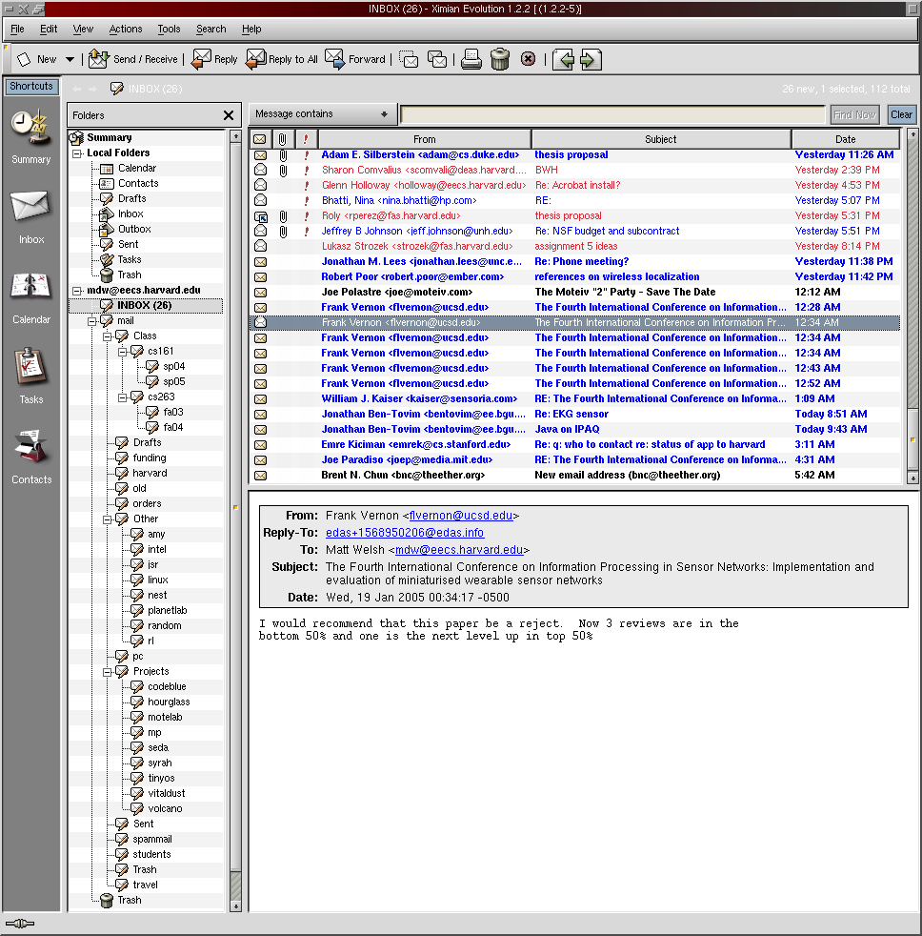
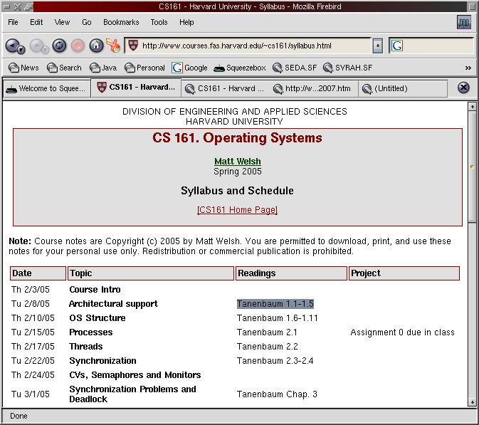
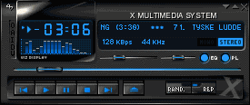
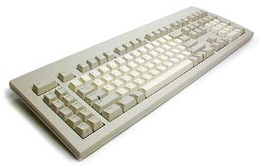
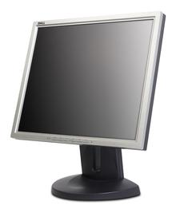
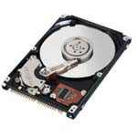
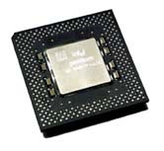

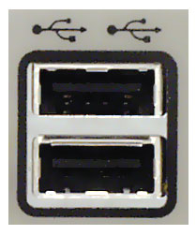
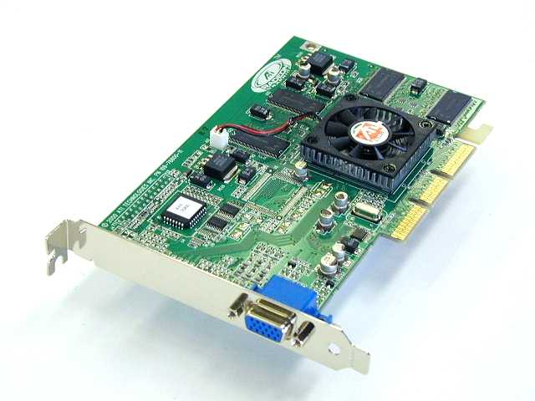
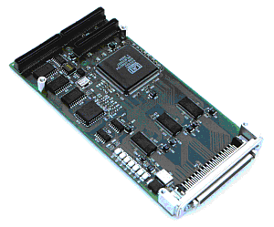
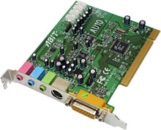
What’s an Operating System?
Software that provides an elaborate illusion to applications
User application
User application
User application
Protection boundary
Kernel
Memory management
Process management
Accounting
Filesystem
TCP/IP stack
Device drivers
Disk I/O
CPU support
Hardware/software
interface
Gnarly world of hardware

Slide 7
What’s an Operating System?
A program that acts as an intermediary between a user of a computer(ized device) and the computer(ized device) hardware.
Abstraction –
Every application thinks it has its own CPU
Every application thinks it has access to its memory space
Every application thinks it has clean/simple interface to hardware devices
Arbitration – Manages access to shared resources.
Which application should be granted CPU now?
Which application should be allocated memory?
Which application should be granted for hardware access?

Slide 8
One OS Function: Concurrency
Give every application the illusion of having its own CPU!
I think I have my own CPU
So do I!

Slide 9
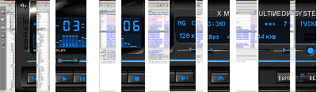
One OS Function: Concurrency
The OS timeslices each application on a single CPU
Switches between applications extremely rapidly, i.e., 100 times/sec
Kernel Scheduler
Timeslice on
single CPU system
time

Slide 10

Another OS Function: Virtual Memory
Give every application the illusion of having infinite memory
And, that it can access any memory address it likes!
In reality, RAM is split across multiple applications
Physical RAM
Code
Code
Data
Data
Stack
Stack
VM System
Code
Code
Data
Data
Stack
Stack
Swap out to disk

Slide 11
More OS Functions
Multiprocessor support
Modern systems have multiple CPUs
Can run multiple applications (or threads within applications) in parallel
OS must ensure that memory and cache contents are consistent across CPUs
Filesystems
Real disks have a hairy, sector-based access model
User applications see flat files arranged in a hierarchical namespace
Network protocols
Network interface hardware operates on the level of unreliable packets
User apps see a (potentially reliable) byte-stream socket
Security and protection
Prevent multiple apps from interfering with each other and with normal system operation

Slide 12
Why bother with an OS?
Not just to give Slashdot readers something to argue about...
Abstract away messy details of hardware
Give apps a nice clean view of the system
Save programmers a lot of trouble when building applications
Allow apps to be ported across a wide range of hardware platforms
Safety!
Don't let applications run amok – keep them in a “sandbox”
e.g., Access to unallocated memory address crashes only the program, not the whole system
Segmentation fault – core dumped
Efficiency
Share one machine across many different apps: concurrent execution
You would be surprised how much slack there is in a typical computer system

Slide 13
Why study operating systems?
Most people will never write one from scratch...
(Though if you do you stand to get incredibly rich)‏
Although more and more people are hacking them (e.g., Linux and BSD)‏
You need to understand the “big picture” in order to hack the details
This class is about much more than the kernel!
Data structures, concurrency, performance, resource management, synchronization, networks, distributed systems, databases ...
The ideas and skills you pick up in this class have broad applications
And it doesn't hurt for those Microsoft interviews either
This course is the basis for future work in other areas of systems
Distributed systems, P2P, sensor nets, etc.

Slide 14
Major OS Design Issues
Structure
How is the OS itself organized? Lots of modules? One big blob of code?
Sharing
How are limited resources multiplexed across users?
Naming
How to programs and users name and access resources?
Security
How to prevent malicious users from compromising the system?
Performance
How to keep it all fast?
Reliability
What happens when a program (or the OS itself) has a bug or failure?

Slide 15
More OS Design Issues
Extensibility
How do users and developers add new features?
Communication
How do programs exchange information?
Concurrency
How are multiple concurrent activities created and controlled?
Scale
What happens when demands on resources increase?
Distribution
How do many computers interact with each other, e.g., to pool resources?
Accounting
How do you track (and maybe charge for) resource usage?

Slide 16

Teaching staff
Instructors:
Section 1: Dr. Yusuf Sahillioglu
Section 2: Dr. Erol Sahin
Section 3: Dr. Onur Tolga Sehitoglu
Section 1 lectures:
Section 2 lectures:
Tuesdays: 10:40-12:30 @ BMB4
Thursdays: 11:40-12:30 @ BMB4
Section 3 lectures:
Teaching assistants:
Mehmet Celik
E-mail: mcelik@ceng
Cagri Utku Apak
E-mail: cakpak@ceng
Notes:
16
18/02/08

Slide 17
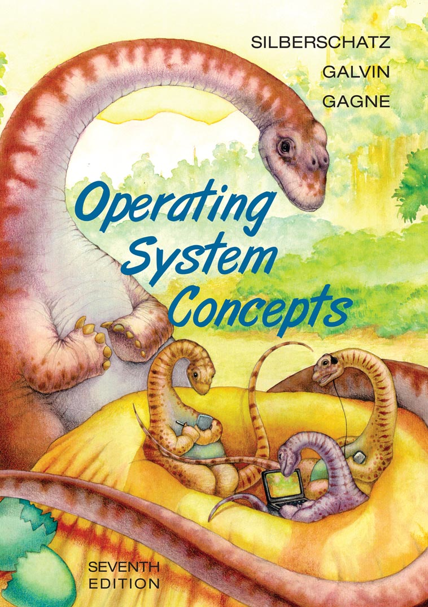
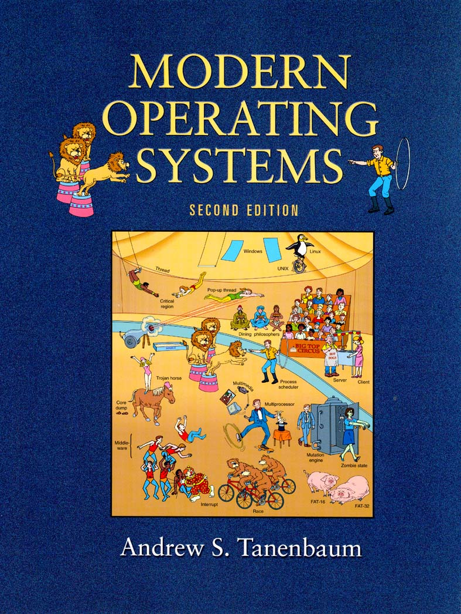
Textbook
Operating System Concepts
Avi Silberschatz
Peter Baer Galvin
Greg Gagne
John Wiley & Sons, Inc.
ISBN 0-471-76907-X
Modern Operating Systems
Andrew S. Tanenbaum
Prentice Hall., 2001,
ISBN-10: 0130313580
ISBN-13: 97801303135
The content of the lectures (slides) will defined the coverage.
Contents of both books are similar, but the presentation may differ.
Pick at your own taste, and follow the lectures.

Slide 18
Grading
23%: Midterm I
23%: Midterm II
24%: Final Exam.
30%: Assignments.

Slide 19

Assignments - To be decided
Assignment 1: Pipes?
Assignment 2: Basic Threading?
Assignment 3: File System?

Slide 20

Policies
Late assignments:
Late submission policy will be announced for each assignment.
Academic dishonesty:
All assignments submitted should be fully your own. We have a zero tolerance policy on cheating and plagiarism. Your work will be regularly checked for such misconduct and any such attempts will be prosecuted:
At all times you have the right to challenge our decisions on cheating, upon which the case will be processed through the disciplinary channels of the university. However, we would like to remind you that, if found guilty, the legal code of the university proposes a minimum of six month expulsion from the university.
Notes:
20
18/02/08

Slide 21
Cheating
What is cheating?
Sharing code: either by copying, retyping, looking at, or supplying a copy of a file.
What is NOT cheating?
Helping others use systems or tools.
Helping others with high-level design issues.
Helping others debug their code.
Notes:
21
18/02/08

Slide 22

Cheating: Caught and punished
Friend
Whole code
Piece of cake for us..
Partial code/ “close collaboration”
Walk on a thin line
Friend who submitted a similar homework in the previous years
Caught, since all previous homework submissions are archived
Internet
Whole code
Partial code
Notes:
22
18/02/08

Slide 23
Web page/communication: PIAZZA
All content and resources will be shared through Piazza.
All discussions and communication should also be done in Piazza.
https://piazza.com/metu.edu.tr/spring2018/ceng334/home
You will get an invitation for Piazza to your metu email shortly.
Don’t forget to accept it.
Also use Piazza app on your Mobile!

Slide 24

Web surfing homework for next lecture..
Learn
More about XEROX PARC
What have they invented
More about Ken Thomson and Dennis Ritchie
What are they known for
More about Microsoft
How did MS-DOS become so successful?
More about Apple
What’s the relation between XEROX PARC GUI and Apple GUI?
What’s Slashdot?
Use Wikipedia, and google the web..

Slide 25
Movie suggestion

